Slide 1
UCF439 Capstone Project FACE DETECTION AND AGE GENDER RECOGNITION Mode A Group No. 48
Under the Supervision of:
Dr. Naveen Kumar
Supervisor Email:
naveen.kumar@dituniversity.edu.in
Satyam Raj (1000015607)
Rishav Kumar (1000014613)
Dhanraj Kumar (1000014261)
B.Tech CSE

Slide 2
TABLE OF CONTENTS
PROJECT OBJECTIVE INTRODUCTION | 3 4
BACKGROUND WORK | 5-8
FEASIBILITY STUDY | 9-11
PROBLEM STATEMENT | 12
TECHNIQUES | 13
ALGORITHMS | 14
METHODOLOGY | 15-19
RESULTS | 20-23
TIMELINE | 24
REFERENCES | 25

Slide 3
PROJECT OBJECTIVE
Building a deep learning models to predict age and gender from facial images such as CNN Model, Caffee Model, Support Vector Machine.
Utilizing the UTKFace dataset, a comprehensive collection of annotated facial images, for model training and evaluation.
Evaluating the performance of the trained model on test data and assessing its accuracy in age and gender prediction tasks.

Slide 4
INTRODUCTION
GENDER PREDICTION
Gender identity is the process through which people identify and assign a gender to themselves or other people. It includes recognizing and interpreting gender cues in other people as well as one's own internal sense of gender identity. Using facial recognition algorithms and machine or deep learning models in particular, face biometrics allows for the analysis and inference of an individual's likely gender from their facial traits.
GENDER PREDICTION
MALE
FEMALE

Slide 5
BACKGROUND/RELATED WORK
Researchers have been working on gender recognition and estimation for years. They used several deep learning algorithms to do so, and they worked hard to enhance the accuracy and precision of gender estimation from a person’s photo. Many deep learning algorithms were used in face detection, face recognition, gender recognition and identification.
Face Detection
Several algorithms were proposed for face detection such as Viola and Jones algorithms. Viola and Jones applied rectangular boxes for the face.[1]
Another algorithm is the Haar Cascade classifier which has been used for human detection and face detection. It was given by Open Source Computer Vision (OpenCV) libraries.[2-4]
Other algorithms commonly used in face detection by OpenCV are HOG, Linear SVM, Single Shot Detectors (SSDs) [3].
Jhilik Bhattacharya et al. used real-time DNN-based face identification for visually impaired persons [6].

Slide 6
BACKGROUND/RELATED WORK
B. Gender Classification
Nagesh Singh Chauhan used CNN and OpenCV to predict the gender of human faces that appear in any video, and the accuracy of his prediction is excellent [7].
Haibin Liao et al. used CNN and Divide-and-Rule strategy for age estimation of face images. They used CNN to extract robust features from the images, then a divide-and-rule face age estimator is proposed. They proved that the performance of divide-and-rule estimators is much better than classical SVM and SVR.[8]
Unicar, Michal, et al. proposed structured SVM classifier to predict gender from a single face image by deep features[9].
Olatunbosun Agbo-Ajala and Serestina Viriri proposed a novel CNN model to extract features from unconstrained real-life face images and classified them to gender groups. They achieved classification accuracy of 89.7% on gender [10].

Slide 7
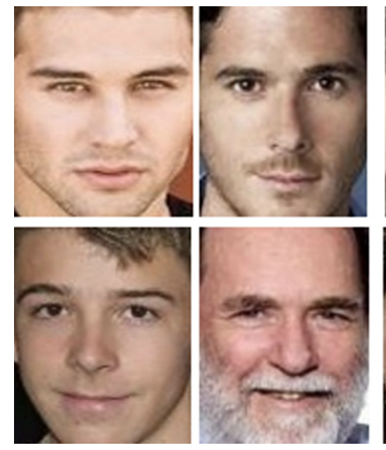
UTKFace DATASET
The UTKFace dataset is a comprehensive collection of facial images curated specifically for age and gender recognition tasks.
It contains over 20,000 images of human faces, annotated with age, gender, and ethnicity information.
Each image in the dataset is labeled with the person's age, ranging from 0 to 116 years old.
Gender is classified as male or female, providing a binary classification for gender prediction tasks.

Slide 8
Year | Technique/Model | Dataset | Performance Metric | Results | Advantages | Limitations | References
2019 | CAFFE model | Facial dataset | Accuracy | 72% | Detect multiple faces in single image. | Various face characteristics are removed | [11]
2020 | CNN Model | student faical dataset | Accuracy | 82% | It has overall accuracy of 82%. | not give the mustache enough weight in gender prediction. | [12]
2022 | CNN Model | IMDB-WIKI | N/A | N/A | Training on large datasets | The paper doesn't explicitly mention the evaluation metrics used to assess the performance of the proposed method. | [13]
2019 | CNN Model | Adience Benchmark dataset | Accuracy | 80.11% | The proposed CNN model, especially when trained with Deep Multi-task Learning (DMTL), demonstrates high accuracy | large datasets like the Adience Benchmark dataset, can be computationally intensive and time-consuming | [14]

Slide 9
FEASIBILTY STUDY - TECHNICAL
Language Used: Python
Python: Python is an interpreted, object-oriented, high-level programming language with dynamic semantics. Its high-level built in data structures, combined with dynamic typing and dynamic binding, make it very attractive for Rapid Application Development, as well as for use as a scripting or glue language to connect existing components together.
Dataset Used: UTKFace Dataset
Platform: PyCharm
Deep Learning Models: Caffe and CNN Model, SVM
Caffe: Caffe, stands for Convolutional Architecture for Fast Feature Embedding, is a deep learning framework developed by the Berkeley Vision and Learning Center (BVLC). It's primarily designed for computer vision tasks, although it can be used for other types of deep learning applications as well.
Caffe provides an efficient and scalable architecture for building, training, and deploying deep neural networks.
CNN: Convolutional Neural Network (CNN) is the extended version of artificial neural networks (ANN) which is predominantly used to extract the feature from the grid-like matrix dataset. For example visual datasets like images or videos where data patterns play an extensive role.

Slide 10
FEASIBILTY STUDY - ECONOMICAL
The economic feasibility of gender prediction using facial biometrics depends on several factors, including:
Development Costs:
In-house development: Requires skilled data scientists and engineers, leading to high salaries and potential infrastructure costs.
Pre-trained models and APIs: Can reduce development time and costs but incur licensing fees.
Data Acquisition:
Public datasets: Free to use, but might not be diverse or well-suited for specific applications.
Private datasets: Require licensing or data collection efforts, which can be expensive.
Computational Resources: Training deep learning models often necessitates powerful GPUs or cloud platforms, incurring ongoing costs.

Slide 11
FEASIBILTY STUDY - OPERATIONAL
Operational feasibility refers to the practicality of implementing and using gender prediction with facial biometrics in real-world scenarios.
Technical Requirements:
Hardware: Facial recognition systems require cameras with good resolution and potentially specialized hardware for deep learning inference, especially for real-time applications.
Software: The chosen deep learning framework needs to be compatible with the deployment environment (cloud, edge devices).
Computational Resources: For real-time processing, the system must have sufficient processing power (CPUs, GPUs) to handle image analysis and prediction within acceptable timeframes.
Deployment Considerations:
System Integration: The system needs to integrate seamlessly with existing infrastructure (cameras, access control systems).
Network Connectivity: Reliable internet connection is often required for communication with cloud-based training/inference or real-time data processing.
Scalability: The system should be scalable to accommodate future growth in user base or data volume.

Slide 12
PROBLEM STATEMENT
Gender prediction using facial biometrics aims to create a robust and accurate system that can automatically classify individuals into male or female categories based solely on facial images or video frames. The task involves extracting discriminative facial features from the images and utilizing machine learning or deep learning techniques to make gender predictions.

Slide 13
TECHNIQUES
IMAGE PROCESSING
Image Processing (IP) is a computer technology applied to images that helps us process, analyse and extract useful information from them.
Machine Learning and Deep Learning algorithms uses image processing to predict the gender of individuals. The algorithms learn from the patterns based on the training data with particular parameters.
Techniques
Deep learning
Machine Learning
MACHINE LEARNING
Machine learning is a subfield of artificial intelligence that focuses on the development of algorithms and statistical models that enable computers to learn and make predictions or decisions without being explicitly programmed. It involves training algorithms on large datasets to identify patterns and relationships and then using these patterns to make predictions or decisions about new data.
DEEP LEARNING
Deep learning is the subset of machine learning methods based on artificial neural networks with representation learning. It mimics the intricate decision-making ability of the human brain by using multi-layered neural networks, also known as deep neural networks. It simulates how some forms of information are acquired by humans. Deep learning models can be trained to identify patterns in images, text, audio, and other types of data, as well as to carry out categorization tasks.

Slide 14
WORKING ON MODELS
KNN
LOGISTIC REGRESSION
LINEAR REGRESSION
DECISION TREE
RANDOM FOREST
PREDICT
CLASSIFY
CNN
CAFFE
KERAS

Slide 15
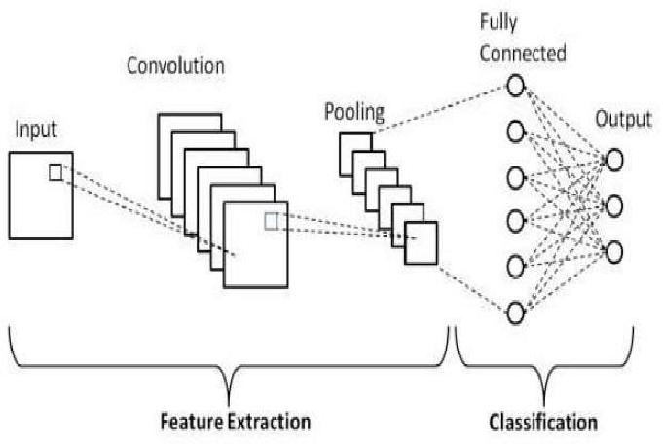
ALGORITHMS
CNN MODEL
Convolutional Neural Network (CNN) is the extended version of artificial neural networks (ANN) which is predominantly used to extract the feature from the grid-like matrix dataset. For example visual datasets like images or videos where data patterns play an extensive role.
Fig-3 -Basic-CNN-architecture-I-Gender-and-Age-Classification

Slide 16
ALGORITHMS
CAFFE MODEL
Caffe, stands for Convolutional Architecture for Fast Feature Embedding, is a deep learning framework developed by the Berkeley Vision and Learning Center (BVLC). It's primarily designed for computer vision tasks, although it can be used for other types of deep learning applications as well. Caffe provides an efficient and scalable architecture for building, training, and deploying deep neural networks.
SUPPORT VECTOR MACHINE
A support vector machine (SVM) is a machine learning algorithm that uses supervised learning models to solve complex classification, regression, and outlier detection problems by performing optimal data transformations that determine boundaries between data points based on predefined classes, labels, or outputs. SVMs are widely adopted across disciplines such as healthcare, natural language processing, signal processing applications, and speech & image recognition fields.

Slide 17
METHODOLOGY
Data Loading and Preprocessing:
loaded images from the UTKFace dataset, preprocess them, and extract age and gender labels from the filenames.
2. Data Visualization:
visualized the distribution of ages in the dataset using a histogram.
3. Model Construction:
The model takes grayscale images of size 64x64 as input and predicts both age and gender.
4. Model Training:
compiled the model with appropriate loss functions and metrics for both age and gender prediction.
5. Model Evaluation and Visualization:
visualize the training and validation loss over epochs to monitor the model’s performance.
6. Inference and Visualization:
provide functions to make predictions on new images using the trained model and visualize the results.
The project employs a combination of Convolutional Neural Networks (CNNs) and Support Vector Machines (SVMs) for gender and age detection. The CNN model is responsible for extracting meaningful features from the facial images, while the SVM classifier is employed for the final classification.

Slide 18
METHODOLOGY
TRAIN PHASE :
DATASET OF IMAGES
SPLIT DATASET FOR TRAINING AND VALIDATION
DEFINE MODEL
BUILD MODEL
COMPILE MODEL
TRAIN MODEL

Slide 19
TEST PHASE
DETECT IMAGE
READ FRAME
APPLY FACE DETECTION
PRE-PROCESSING
DISPLAY RESULT

Slide 20
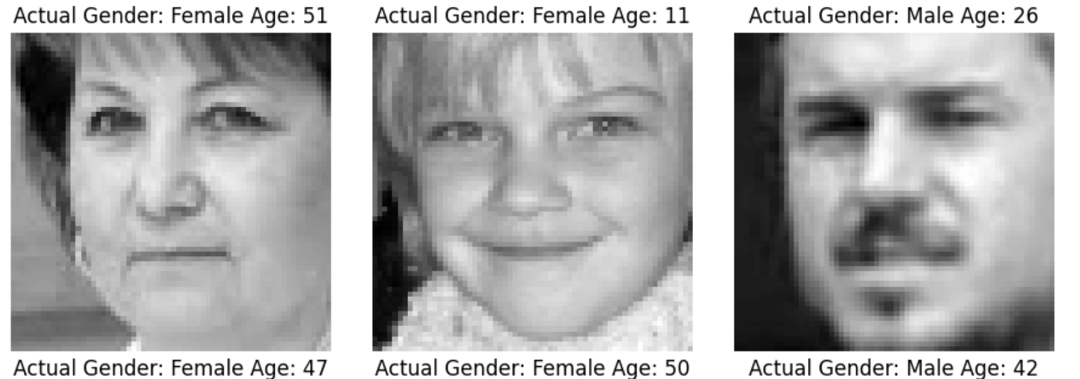
RESULTS
Our proposed solution was implemented using the CNN model to predict user gender. Two gender (Male and Female) and used for testing and evaluating the student’s gender.
Case 1: Testing Images input using CNN Model

Slide 21
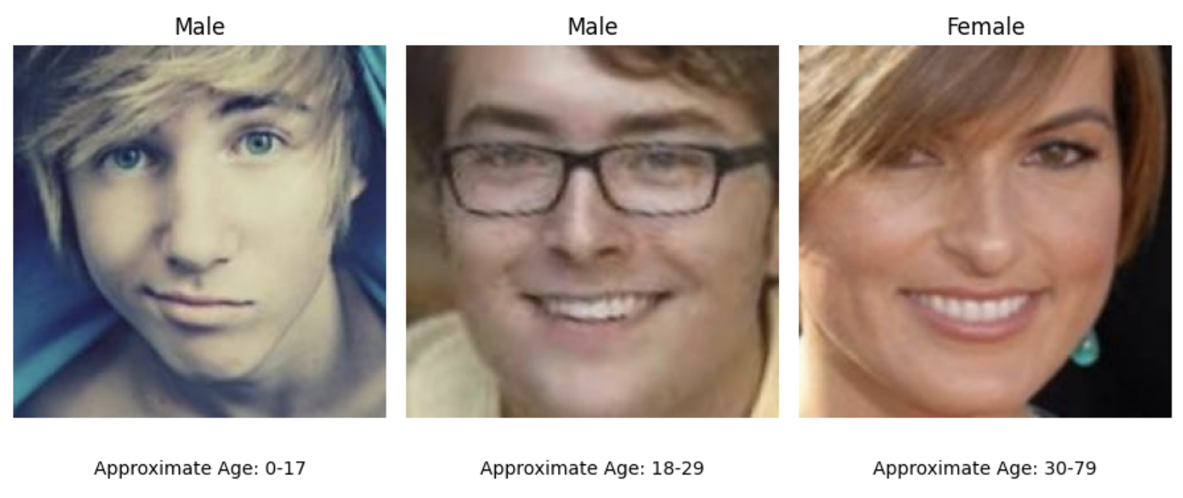
Case 2: Testing Dataset of Images Using Support Vector Machine

Slide 22
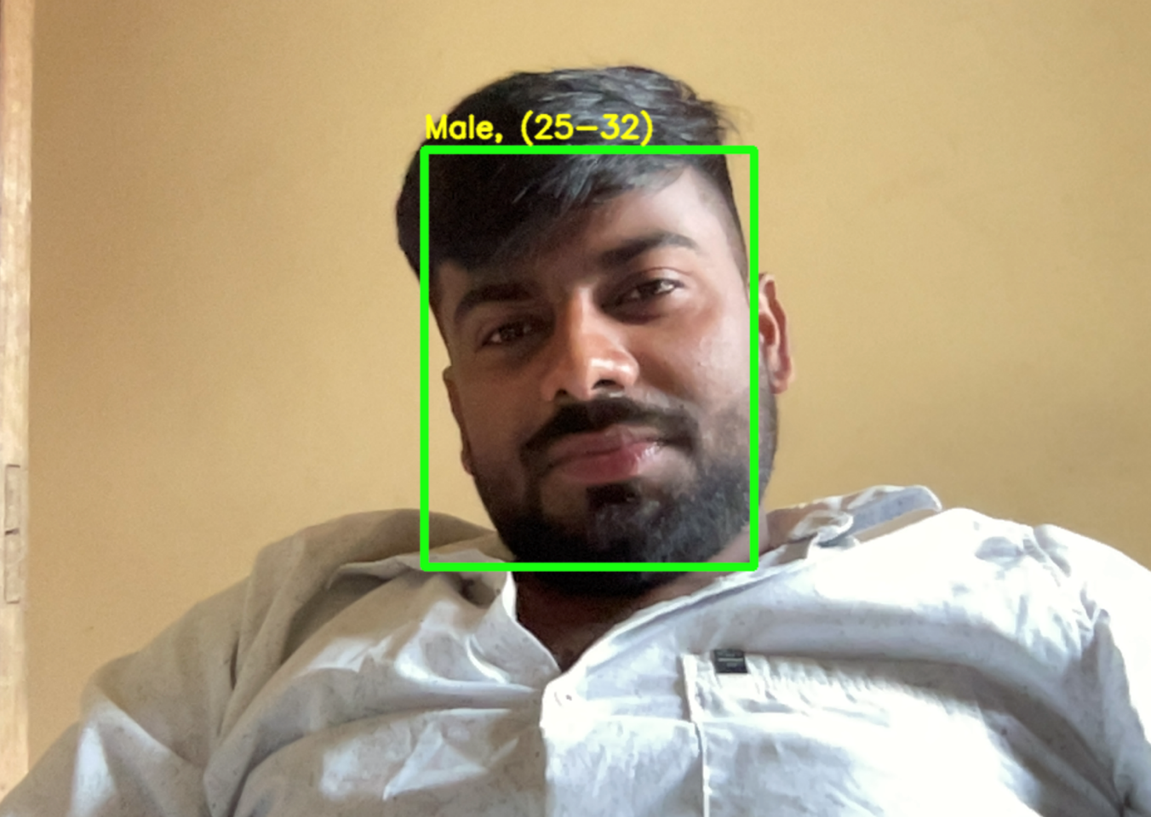
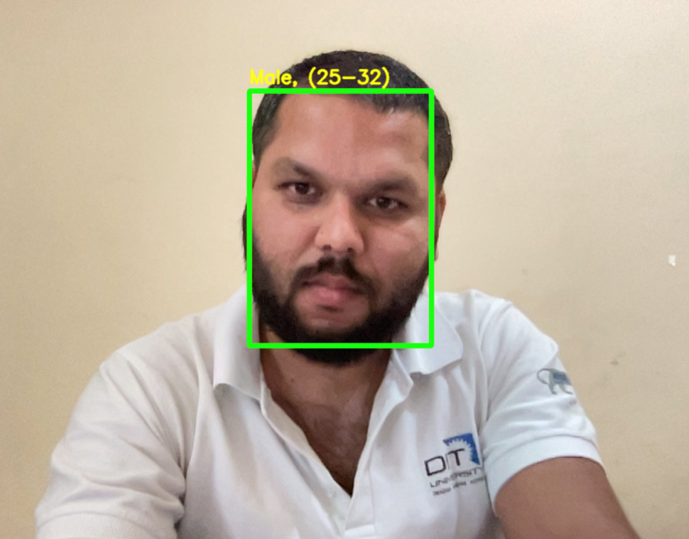
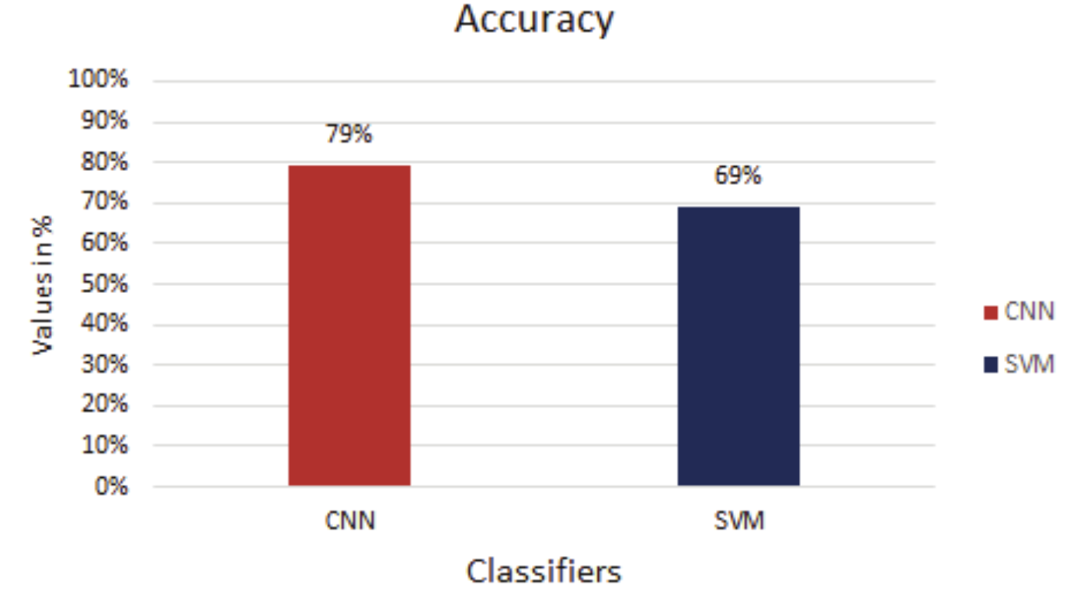
Case 3: Real-time captureing

Slide 23
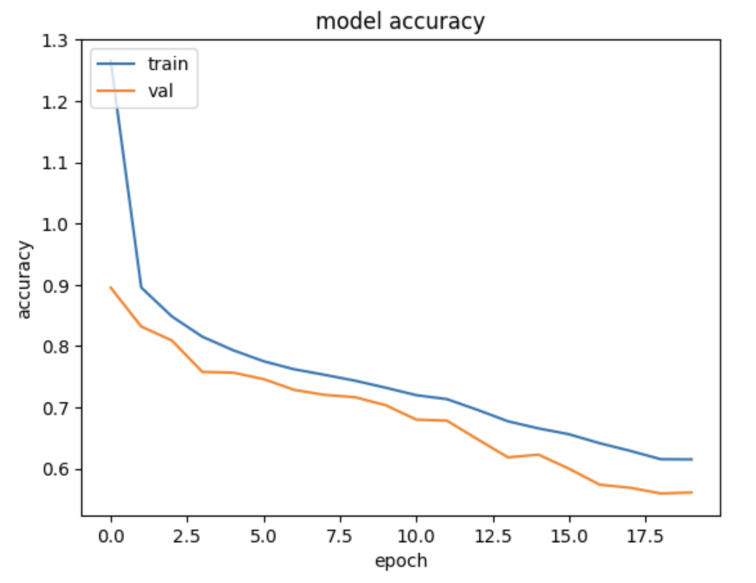
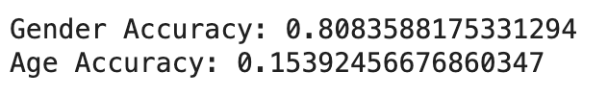
Model Accuracy
Fig. (5) CNN Model Accuracy Diagram

Slide 24
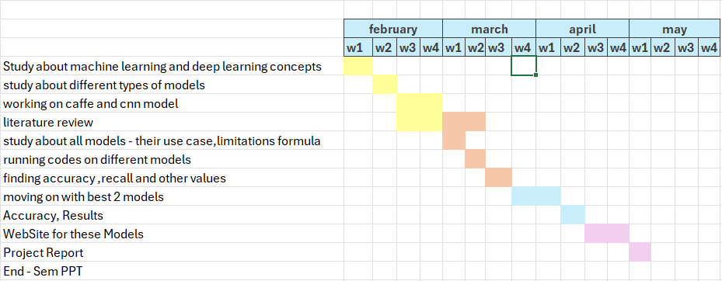
TIMELINE

Slide 25
REFERENCES
[1] Paul Viola and Michael J Jones. Robust real-time face detection. International journal of computer vision, 57(2):137–154, 2004.
[2] Savas, Burcu Kir, Sumeyya Ilkin, and Yasar Becerikli. "The Realization of Face Detection and Fullness Detection in Medium by Using Haar Cascade Classifiers." 2016 24th Signal Processing and Communication Application Conference (SIU), 2016. doi:10.1109/siu.2016.7496215.
[3] Rath, Subrat Kumar, and Siddharth Swarup Rautaray. "A survey on face detection and recognition techniques in different application domain." International Journal of Modern Education and Computer Science 6.8 (2014): 34
[4] Hatem, Hiyam, Zou Beiji, and Raed Majeed. "A survey of feature base methods for human face detection." International Journal of Control and Automation 8.5 (2015): 61-78
[5] E. Alajrami, H. Tabash, Y. Singer and M. Astal, "On using AI-Based Human Identification in Improving Surveillance System Efficiency", 2019 International Conference on Promising Electronic Technologies (ICPET), 2019. Available: 10.1109/icpet.2019.00024 [Accessed 4 June 2020].
[6] Bhattacharya, Jhilik, et al. "Real-time DNN-based Face Identification for the Blind." International Conference on Applications in Electronics Pervading Industry, Environment and Society. Springer, Cham, 2017.
[7] N. Chauhan, "Predict Age and Gender using Convolutional Neural Network and openCV", Medium, 2020. [Online]. Available: https://towardsdatascience.com/predict-age-and-gender-usingconvolutional-neural-network-and-opencv-fd90390e3ce6. [Accessed: 05- Jun- 2020].
[8] Liao, Haibin, et al. "Age estimation of face images based on CNN and divide-and-rule strategy." Mathematical Problems in Engineering, 2018
[9] Uricár, Michal, et al. "Structured output svm prediction of apparent age, gender and smile from deep features." Proceedings of the IEEE Conference on Computer Vision and Pattern Recognition Workshops. 2016.
[10] O. Agbo-Ajala and S. Viriri, "Face-Based Age and Gender Classification Using Deep Learning Model", Image and Video Technology, pp. 125-137, 2020.
[11] Shaban, S., Singh, R. P., & Mehra, Dr. M. (2022). Age and Gender Prediction using Caffe Model and OpenCV. International Journal of Innovative Research in Computer Science & Technology, 15–21.
[12] AMA Nada, E Alajrami, AA Al-Saqqa… - Int. J. Acad. Eng. Res …, 2020 - academia.edu
[13] Shaban, S., Singh, R. P., & Mehra, Dr. M. (2022). Age and Gender Prediction using Caffe Model and OpenCV. International Journal of Innovative Research in Computer Science & Technology, 15–21. https://doi.org/10.55524/ijircst.2022.10.1.4
[14] Al-Azzawi, D. S. (2019). Human Age and Gender Prediction Using Deep Multi-Task Convolutional Neural Network. Journal of Southwest Jiaotong University, 54(4). https://doi.org/10.35741/issn.0258-2724.54.4.11

Slide 26
THANK YOU

